Slide 1

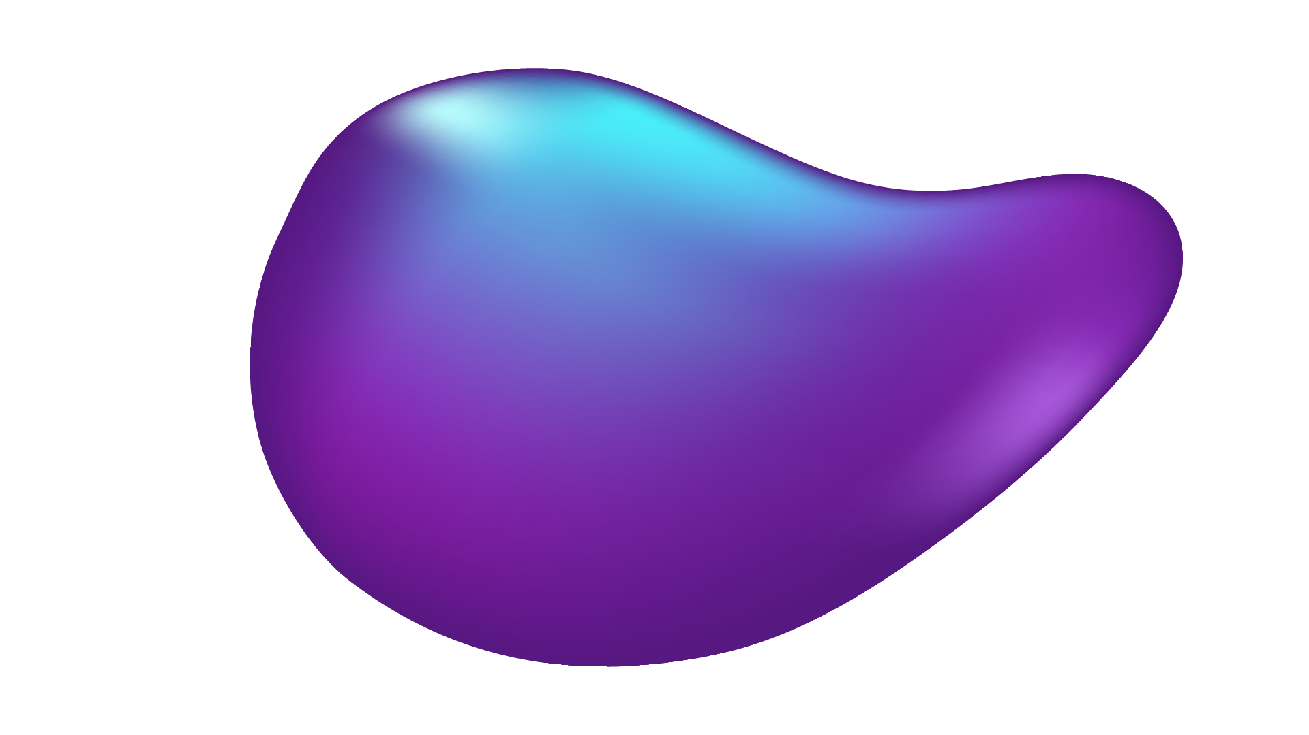
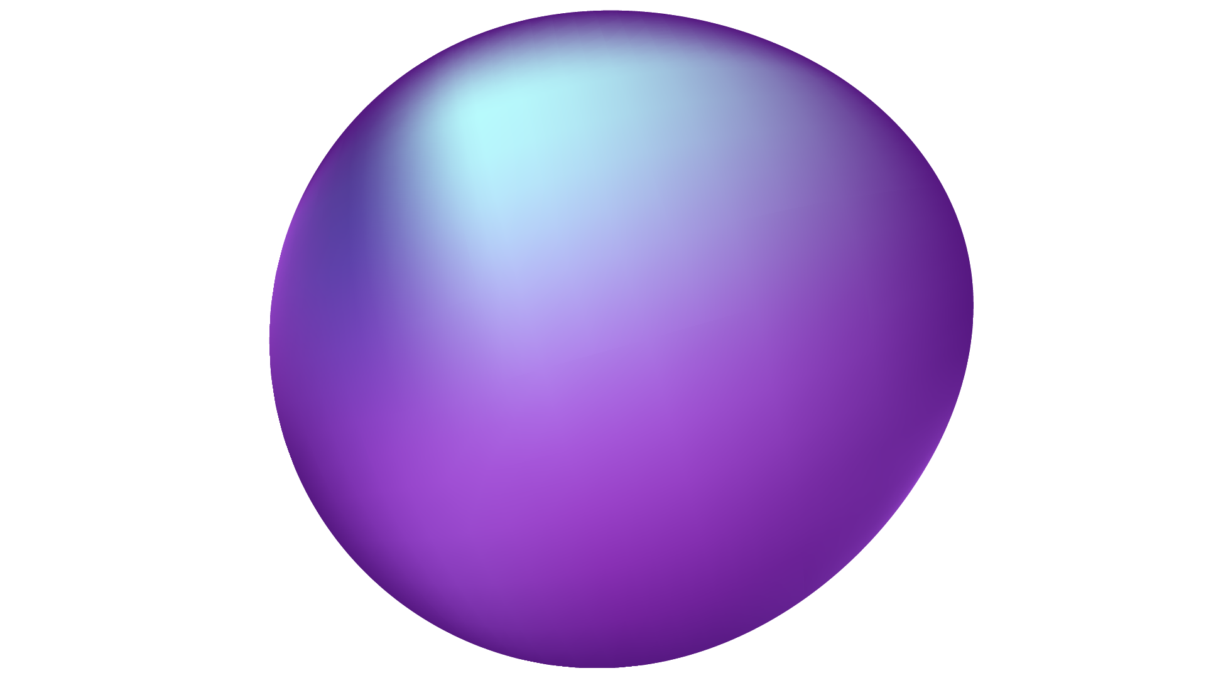
An Overarching YOLO Performance Analysis
Groups: A, F, G, I

Slide 2
TABLE OF CONTENTS
01
02
03
04
05
ABSTRACT / INTRODUCTION
HARDWARE & SOFTWARE
METHODOLOGY
RESULTS
FUTURE WORK

Slide 3
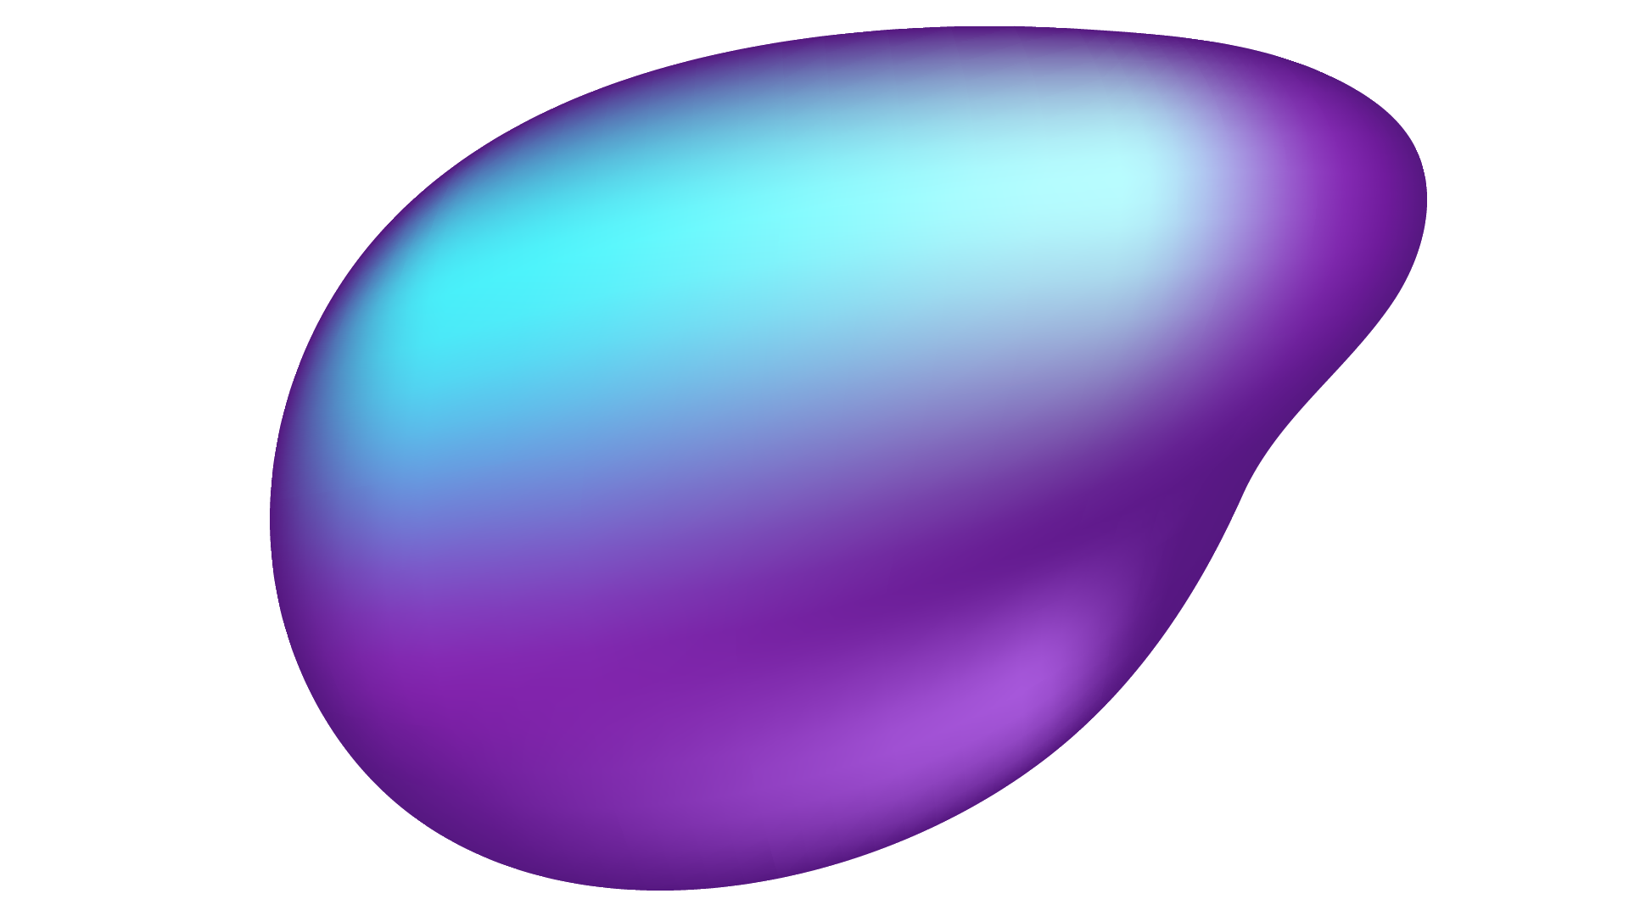

ABSTRACT
Object Detection is Critical for Robotics, Surveillance, and Autonomous Systems
This Study Benchmarks YOLOv5 and YOLOv8 on CPUs, GPUs, and Edge Devices
Objective: Provide Insights into Trade-Offs for Hardware and Model Selection
Key Results:
YOLOv8 Excels in Speed & Accuracy, Especially on Edge Devices
Discrete GPUs are the Most Efficient, up to 27.23x Better than CPUs

Slide 4
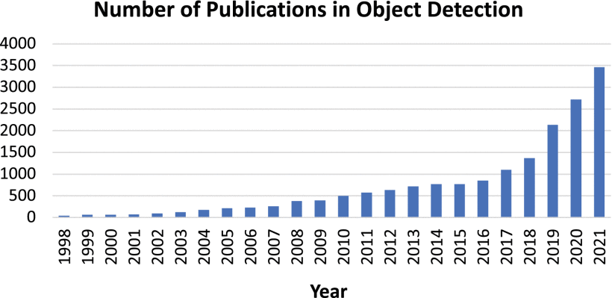
Introduction
Object Detection: Identifying Objects in Images or Video
Importance: Applications in Robotics,, Autonomous Systems, Surveillance
Research Question: How do YOLOv5 & v8 Perform on Different Hardware Platforms

Slide 5
HARDWARE CONFIGURATIONS
1
2
3
HIGH-
PERFORMANCE SYSTEMS
INTEGRATED GRAPHICS
EDGE DEVICES
System 1: Intel i7-12700KF, NVIDIA RTX 4080
System 2: AMD Ryzen 9 5950X, AMD Radeon RX 6900 XT
Intel i5-11400H (UHD Graphics), AMD Ryzen 5 5600G (Vega 7 Graphics)
NVIDIA Jetson Orin Nano, NVIDIA Jetson Nano

Slide 6



SOFTWARE FRAMEWORKS
Operating Systems:
Windows 10
Ubuntu 20.04 LTS
Frameworks:
YOLOv5 (Exported to ONNX for Compatibility)
YOLOv8 (Native Framework, PyTorch 1.12.0)
OpenCV and Roboflow for Dataset Handling
Monitoring Tools: HWiNFO64, psutil

Slide 7
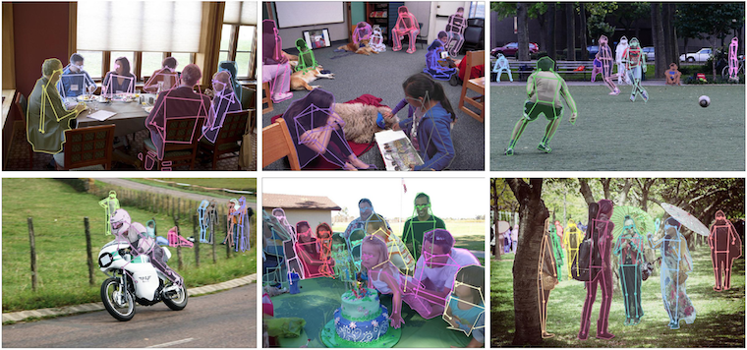
METHODOLOGY
Dataset: COCO 2017 Val (128 Images, Batch Size 16)
Metrics:
Throughput: Images/Sec
Inference Time: Processing Time/Image
Power Efficiency: Watts per Image/Sec
Memory Utilization: CPU & GPU Memory Usage
Process:
GPU Testing First to Avoid Interference
Removed Any Unnecessary Background Processes
Metrics Tracked During Each Test

Slide 8
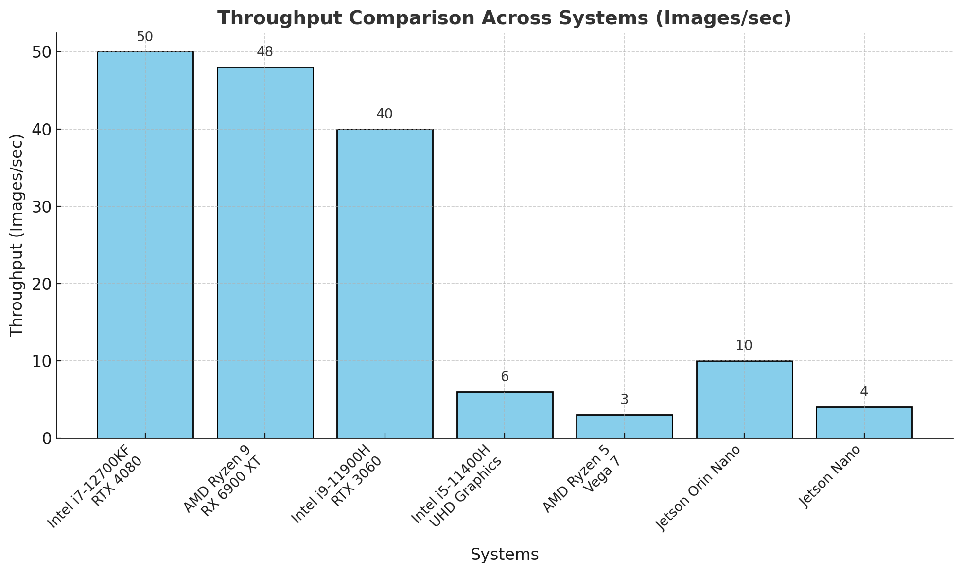
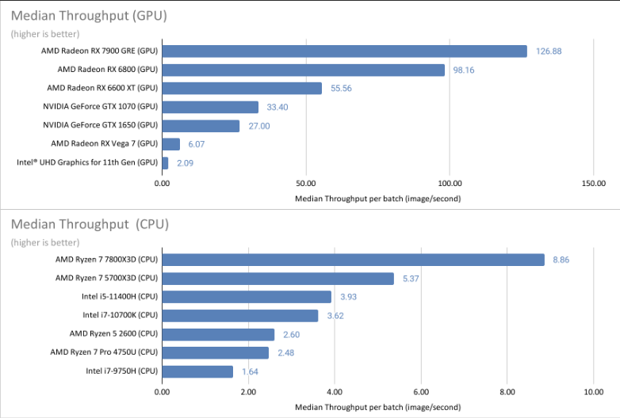
Results - Throughput
Observation:
GPUs Outperform CPUs Significantly; Integrated GPUs see Lesser Performance Uplift versus CPUs
RTX4080 (System 1) Achieves over 50 Images/Sec
Jetson Nano (<5 Images/Sec) Limited by Processing Power

Slide 9
Results - Power Efficiency
System | Power Efficiency (Watts Per Image)
Intel i7-12700KF + RTX 4080 | 1.5
AMD Ryzen 9 + RX 6900 XT | 1.8
Intel i9-11900H + RTX 3060 | 2.2
Intel i5-11400H + UHD Graphics | 6.0
AMD Ryzen 5 + Vega 7 | 8.0
Jetson Orin Nano | 4.0
Observation:
Discrete GPUs Most Efficient (1.5-2W/Image/Sec)
Jetson Orin Nano is Efficient for Edge Devices (~4 W/Image/Sec)
Integrated GPUs Consume More Power for Lower Throughput

Slide 10
YOLOv5 vs YOLOv8 Comparison
Metric | YOLOv5 | YOLOv8
Throughput | Lower (Robust in Varying Environments) | Higher (Suited for Real-Time Applications)
Inference Time | Higher (Slower Processing) | Lower (Faster Processing)
Detection Confidence | Higher at Longer Distances | Slightly Lower at Longer Distances
Power Efficiency | Moderate (Less Efficient) | Higher (More Efficient on Edge Devices)

Slide 11
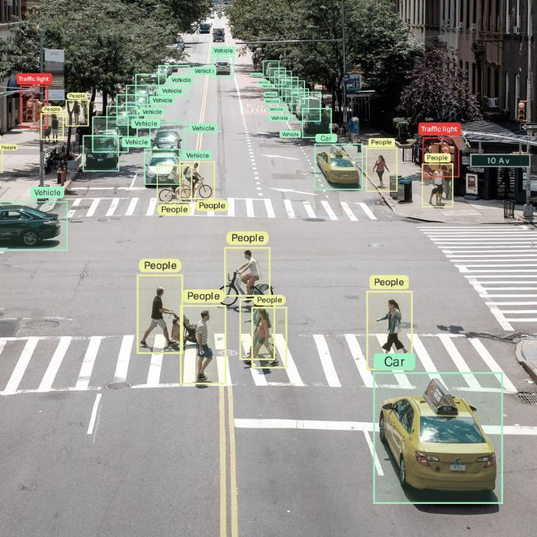
CONCLUSION
Discrete GPUs Excel in Performance, Suitable for Large Scale Tasks
YOLOv8 is Optimal for Real-Time Detection and Edge Devices
YOLOv5 Remains Reliable for Scenarios Requiring Robust Confidence
Key Insight: Model & Hardware Selection Depend on use Case Priorities

Slide 12
FUTURE WORK
GOAL 1
Explore Further Optimizations for YOLO Models on Edge Devices
GOAL 2
Investigate Reducing Memory utilization for Real-Time Tasks
GOAL 3
Expand Benchmarking to Other Detection Models

